Slide 1

Random class and repetition of two-dimensional arrays
Lecturer
Rokas Slaboševičius
Data

Slide 2
Today you will learn
Random class and repetition of two-dimensional arrays
Random class
01
Random class practice
02

Slide 3

Random class
Random class and repetition of two-dimensional arrays
The element of randomness is important in many programming situations, and the C# programming language provides the possibility to use the Random class to generate random numbers.
The Random class gives the programmer control over the generation of numbers according to certain rules, and allows the implementation of random logic.

Slide 4
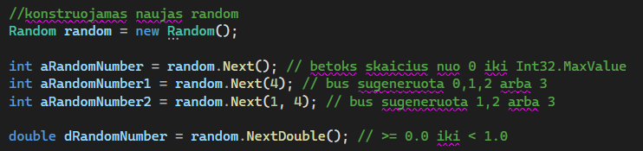
Random class
Random class and repetition of two-dimensional arrays
To use the Random class, you need to initialize it and then you can generate random numbers using its methods.
For example, it is possible to generate random numbers in the range from a specified minimum to a maximum number.
It is also possible to generate random values of type boolean or even random byte sequences of a specified length.

Slide 5
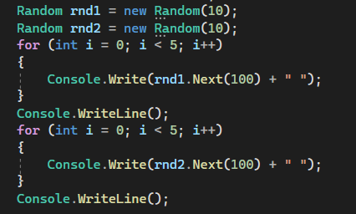
Random class
Random class and repetition of two-dimensional arrays
It is important to note that the Random class uses various algorithms and seeds to generate random numbers.
It is important for the programmer to choose the right seed if predictable results are to be obtained.
It is also important to note that the Random class does not guarantee complete randomness, but provides sufficient functionality for most practical tasks where randomness is required.

Slide 6

Random class and repetition of two-dimensional arrays
Task 1
Create a method that generates random numbers from 1 to 10 and displays them in the console.
Create a method that generates random values of type boolean and displays them in the console.
Create a method that generates a random letter A-Z and displays it on the console. Extend the method so that you can use it to generate a random password.
Design a program that generates random numbers from 1 to 6 and sums them. Repeat this procedure 100 times and display the resulting sums.
Create a program that generates a random number between 1 and 100 and allows the user to guess whether it is greater or less than 50. If the guessed number is larger the program should output "The guessed number is too large" and the correspondingly smaller number.

Slide 7
Random class and repetition of two-dimensional arrays
Task 2
We repeat what we have learnt and do exercises that we didn't do in previous lessons. We consult and work together to solve problems that have caused problems. We ask questions on all topics where there may have been confusion. When we have finished, we continue with further problems found in the slides from Lesson 15. We show how the projects and individual tasks went.

Slide 8
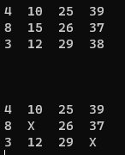
Random class and repetition of two-dimensional arrays
Task 3
Design a method that generates a random matrix of 1 to 8 rows and 1 to 8 columns. Fill it with random numbers from 1-80. Create an additional method that will calculate how many even numbers and how many odd numbers there were in the matrix as percentages. Extend your program so that each column is assigned a decimal counterpart that is specific to its index digit, e.g. the first column should have the numbers 1-9, the second 10-19, the third 20-29, etc. (This will be the ticket drawing functionality). Extend the number generation so that the numbers drawn are not repeated.
Add the functionality to your app to draw a ticket and enter the lottery. After the ticket has been drawn, the app should draw random but NOT random numbers. If the drawn number exists in the ticket, we should see 2 variations of the ticket in the console - one where all the numbers are marked, and one where there is an X instead of the drawn number.
The program should output the number of times the number had to be guessed before it matched the number on the user's ticket. For example: there were 10 draws before you drew X.

Slide 9
Random class and repetition of two-dimensional arrays
Project 1
Supplement the project in Lesson 13 (Tic–Tack-Toe) with „artificial intelligence“.
Your programme should have 4 levels of difficulty:
Easy: The computer plays completely randomly without evaluating what the player is doing
Normal: The computer should play a mix of 50% random and 50% defensive moves.
Difficult: the computer should play a mix of 15% random and 85% defensive moves.
The most complex: The computer should replicate the best moves in all cases. For X, it should use an unbeatable strategy; for O, it should always keep positions in the strongest positions.
Help:
Tic–Tack-Toe have a sequence of moves that is impossible to play around. Write your own algorithm with it in mind https://www.rd.com/article/how-to-win-tic-tac-toe/

Slide 10
Random class and repetition of two-dimensional arrays
https://www.wikihow.com/Beat-Impossible-Tic-Tac-Toe
Useful information

